Slide 1
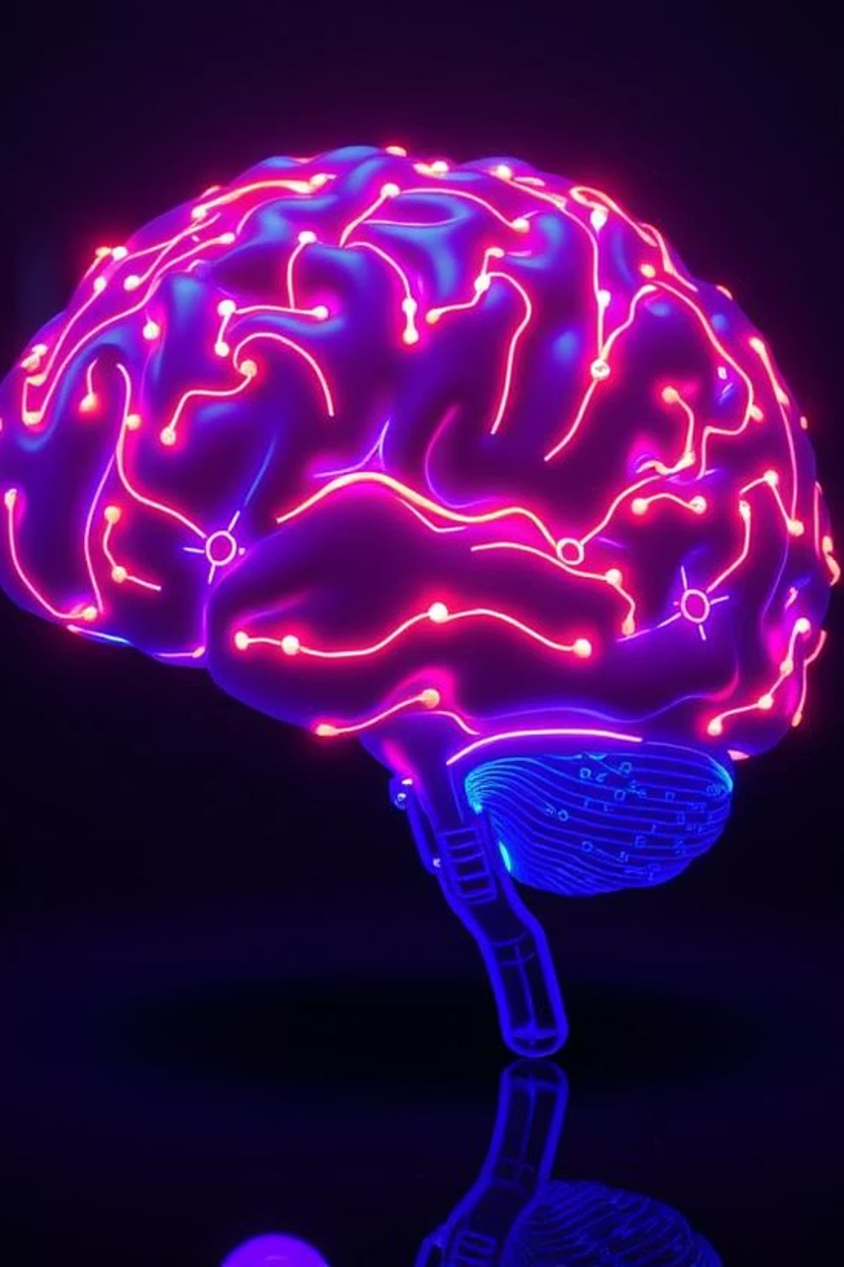
What I Learned from the Artificial Intelligence Course
Combining Theory, Algorithms & Game Projects
Jakaria Chowdhury Tajwone | ID: 0562310005101031
Course Codes: CSE-06133115 (Theory) & CSE-06133116 (Lab)

Slide 2
Course Introduction: Delving into Artificial Intelligence
The Artificial Intelligence course was a comprehensive journey into the fascinating world of intelligent systems. It provided a robust foundation in AI theory and hands-on experience through practical lab work. The primary objective was to understand the core principles that enable machines to mimic human-like intelligence and apply these concepts to solve real-world problems.
Theoretical Foundations
Practical Application
Grasping the 'why' and 'how' behind AI paradigms, from classic algorithms to modern concepts.
Translating theoretical knowledge into functional Python code, solving problems and building AI-driven projects.

Slide 3




Key Concepts from Theory Classes
Our theoretical sessions laid the groundwork, defining what AI truly is and how it diverges from, yet draws inspiration from, human intelligence. We explored fundamental concepts that form the backbone of intelligent systems.
What is AI?
Human vs. Machine Intelligence
Defining intelligence in machines and its historical evolution.
Contrasting cognitive processes and computational capabilities.
Agents and Environments
Knowledge Representation & Reasoning
Understanding intelligent agents acting within specific contexts.
How AI systems store and manipulate information to infer conclusions.

Slide 4
Navigating Problem Spaces: Search Techniques
A significant portion of the course focused on how AI agents find solutions to problems. We explored various search algorithms, crucial for pathfinding, optimization, and decision-making in complex environments.
Classical Search Algorithms
Heuristic and Local Search
These foundational algorithms systematically explore the state space.
For more complex problems, heuristics guide the search, while local search optimizes within a limited neighborhood.
Breadth-First Search (BFS): Finds the shortest path in an unweighted graph.
A* Search: Combines UCS with heuristic estimates for efficient optimal pathfinding.
Depth-First Search (DFS): Explores as far as possible along each branch before backtracking.
Hill Climbing: Iteratively moves towards a better solution by making small changes.
Uniform Cost Search (UCS): Finds the least-cost path in a weighted graph.
Simulated Annealing: Escapes local optima by allowing "bad" moves with decreasing probability.
Genetic Algorithms: Inspired by natural selection for optimization and search.

Slide 5



Strategic Decisions: Game Playing and Constraints
Understanding how AI plays games and solves constraint problems provided insights into adversarial search and logical reasoning. These concepts are fundamental to building intelligent opponents and optimizing resource allocation.
Minimax Algorithm
Alpha-Beta Pruning
Constraint Satisfaction Problems (CSP)
A decision-making algorithm for two-player games where players take turns and aim to minimize the maximum possible loss.
An optimization technique for Minimax, reducing the number of nodes that need to be evaluated in the search tree.
Framework for modeling and solving problems by finding a state that satisfies a given set of constraints or conditions.

Slide 6

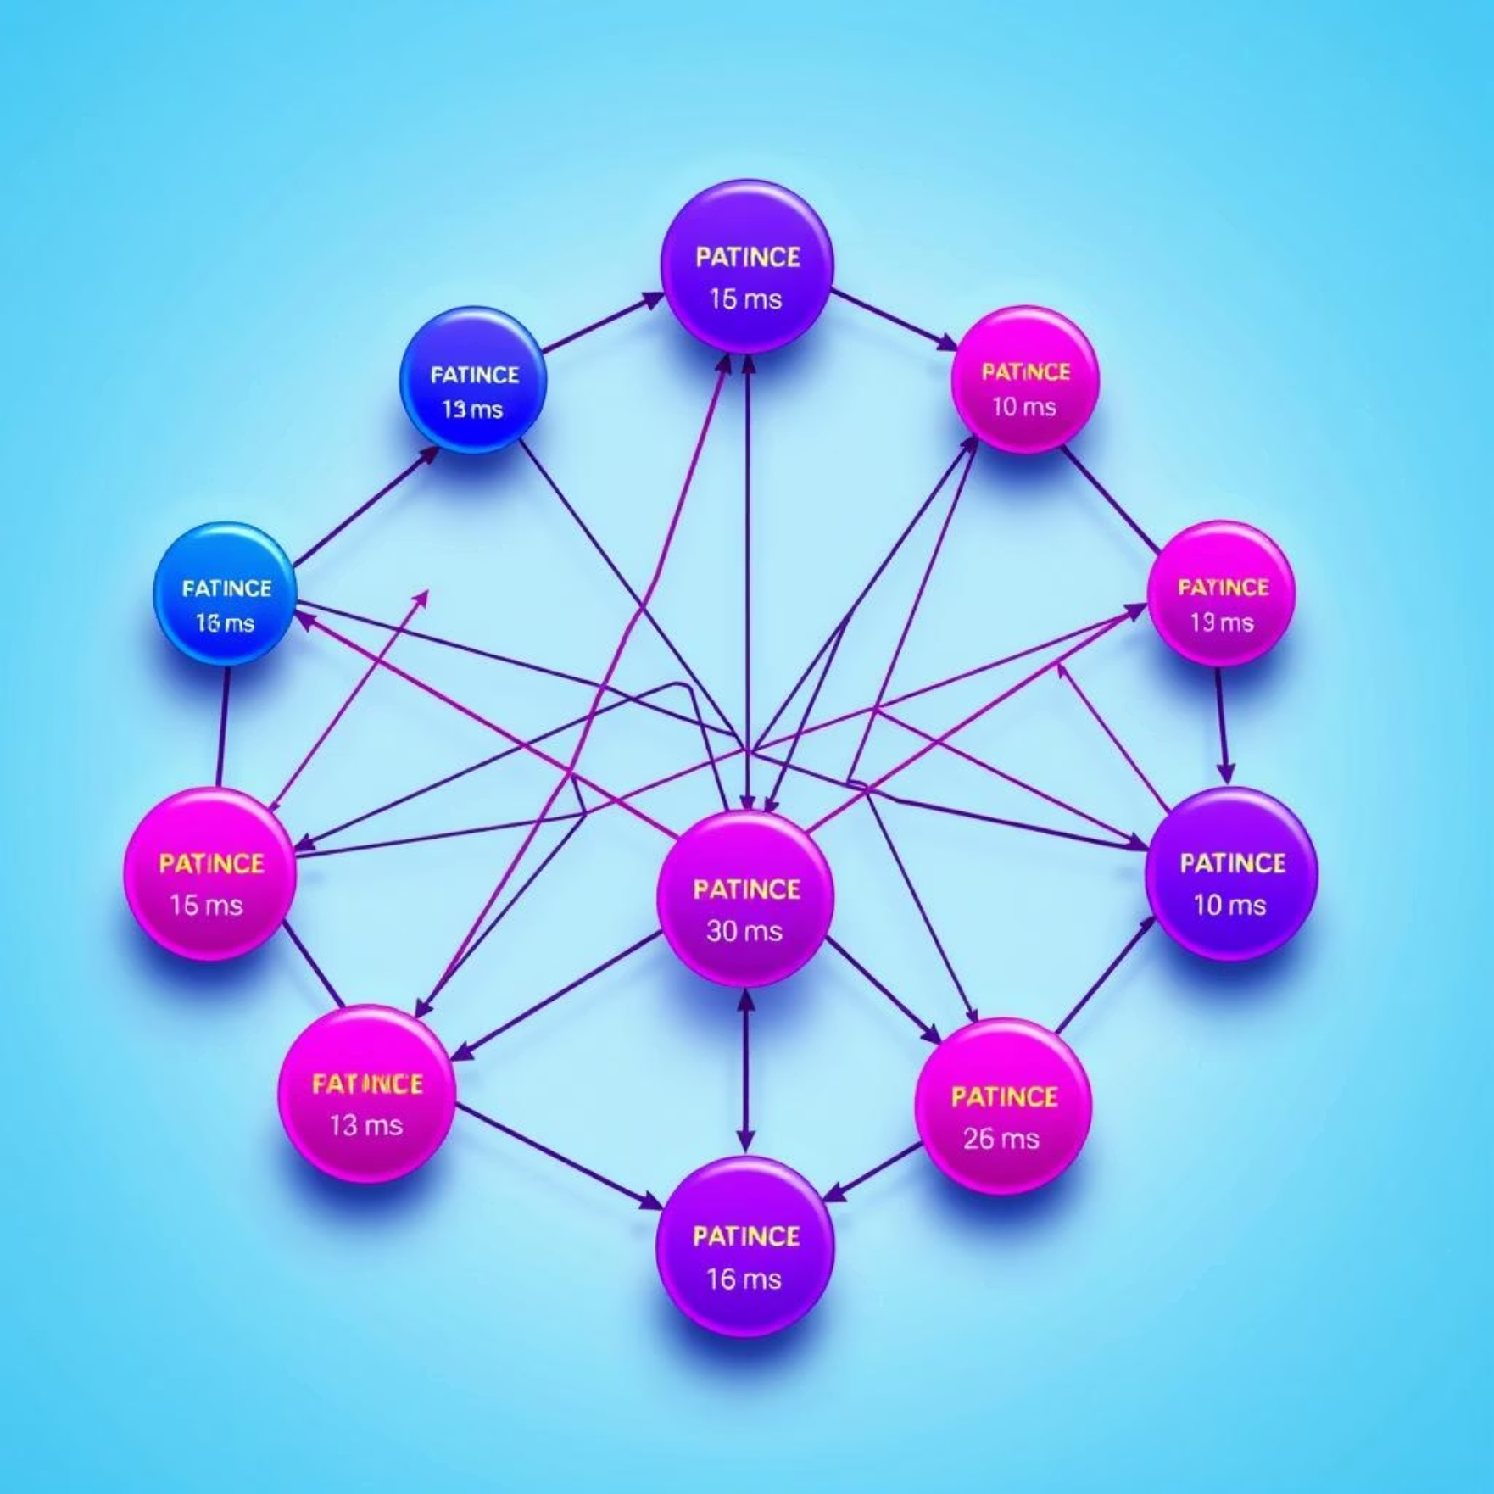
Learning from Experience: Reinforcement Learning & Probabilistic Reasoning
The course delved into how AI agents learn through interaction and how they handle uncertainty, crucial for real-world applications where information is often incomplete or noisy.
Reinforcement Learning
Probabilistic Reasoning
Bellman Equation: Fundamental to dynamic programming and reinforcement learning, describing value functions.
Bayes’ Theorem: Essential for reasoning under uncertainty, allowing us to update beliefs based on new evidence.
Value Iteration & Policy Iteration: Algorithms for solving Markov Decision Processes (MDPs) by finding optimal policies.
Hidden Markov Models (HMMs): For modeling systems with unobserved states, applied in speech recognition and bioinformatics.

Slide 7
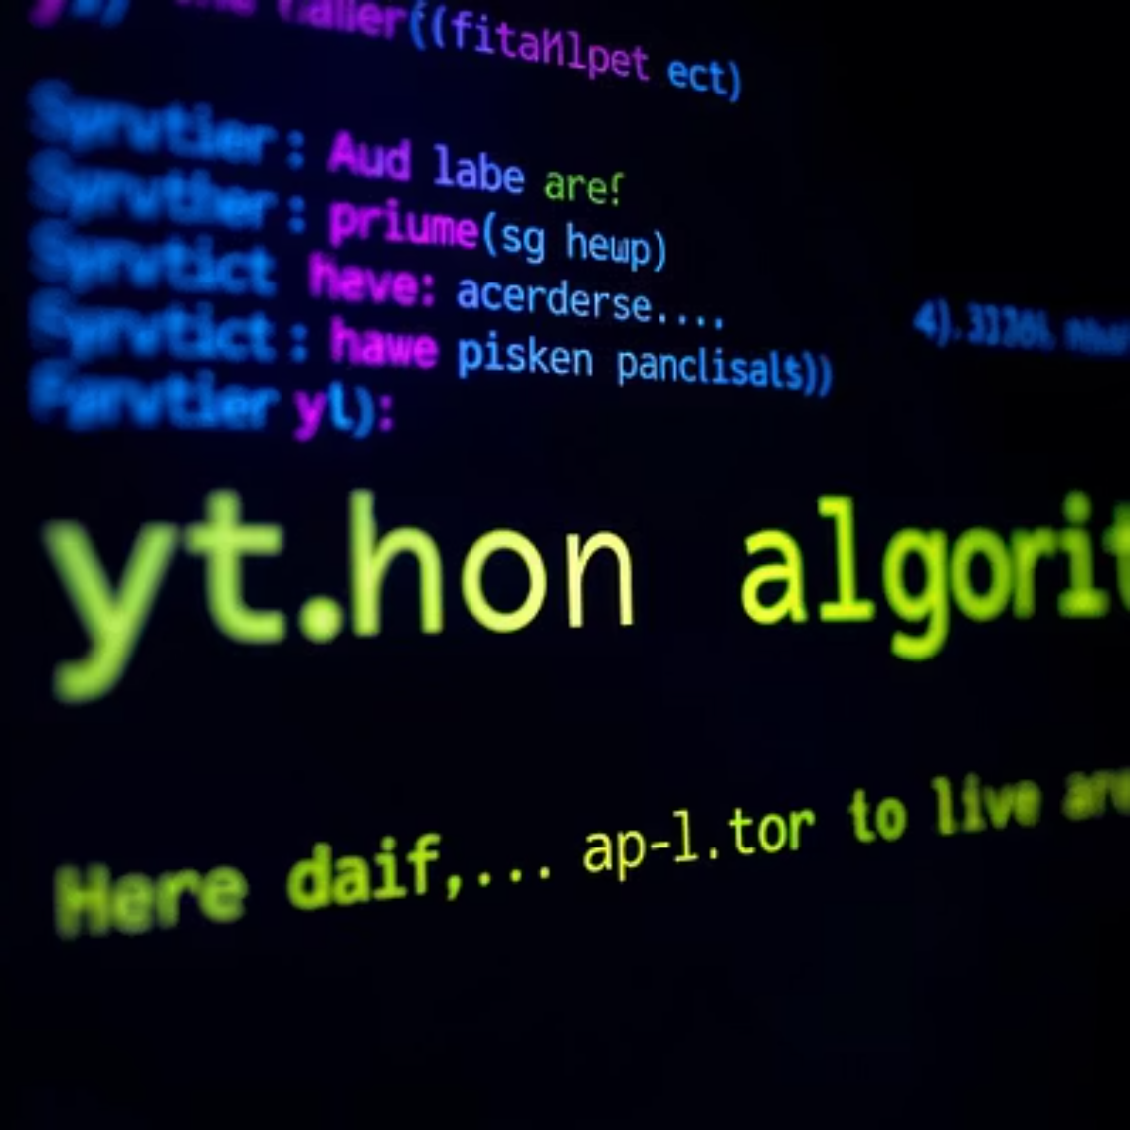
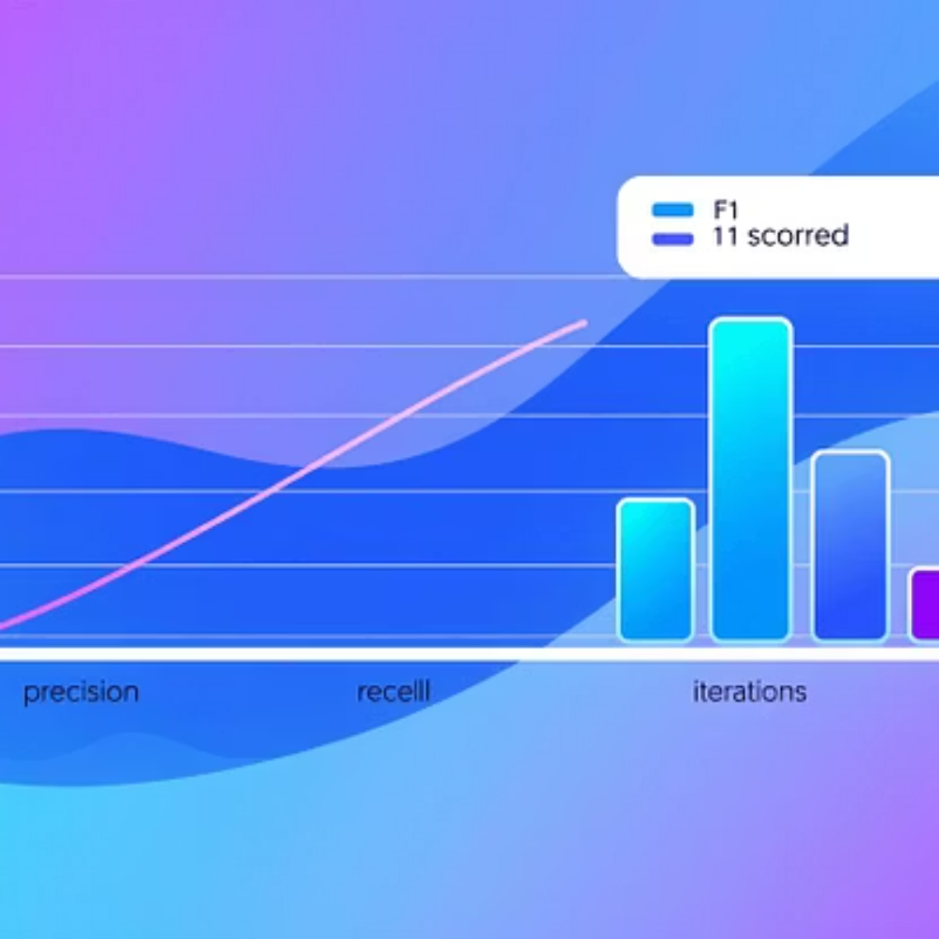




Hands-On Application: Lab Work
The lab sessions were instrumental in solidifying theoretical concepts. We translated algorithms into Python code, observing their behavior and performance firsthand, and gaining invaluable debugging and problem-solving skills.
Implementing Search Algorithms
Testing Performance and Behavior
Experimenting with Logic and Planning
Coding BFS, DFS, A*, and others to navigate mazes and solve puzzles.
Analyzing the efficiency and outcomes of different algorithmic approaches.
Applying logical reasoning and planning techniques to agent behaviors.

Slide 8


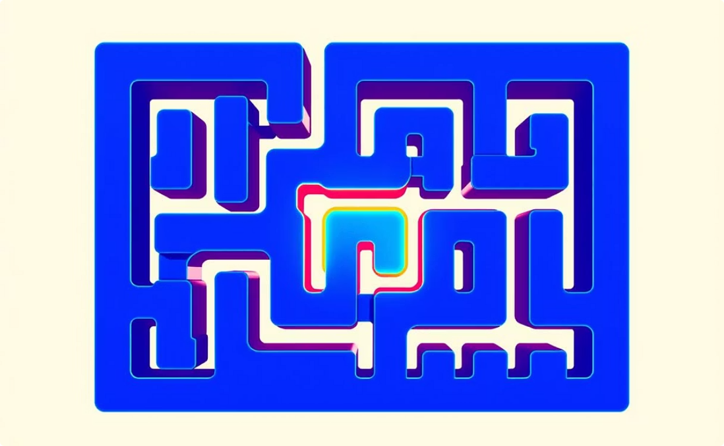
Game Projects I Built: AI in Action
The culmination of our learning was reflected in the game projects, where we integrated various AI algorithms to create intelligent gameplay experiences. These projects brought theoretical concepts to life, demonstrating their practical utility.
Tic Tac Toe with Minimax + Alpha-Beta
Basic AI Chess Logic
Maze Solver using BFS / A*
Developed rudimentary AI for chess, focusing on basic move evaluation.
Created an agent that efficiently finds the shortest path through a maze.
Implemented an unbeatable AI opponent using optimal game theory.

Slide 9



Skills I Gained
Algorithmic Thinking
Debugging & Problem-Solving
AI Game Development
Developed robust problem-solving approaches by designing efficient, step-by-step solutions for complex AI challenges.
Honed critical skills in identifying, diagnosing, and resolving intricate issues within sophisticated AI models and game environments.
Applied core AI concepts to build intelligent agents and dynamic gameplay, translating theory into practical, interactive experiences.

Slide 10
Thank You!
Grateful for the opportunity to share my journey through the Artificial Intelligence course. I look forward to applying these skills in future innovations.

